Slide 1
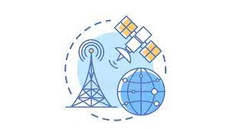
NEXT HIKES Telco Project Task 1-User Overview Analysis
By – Bhavesh Baghele

Slide 2
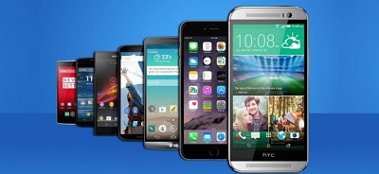
The Top 10 Handsets used by Customers
Huawei B528S-23A 19752
Apple iPhone 6S (A1688) 9419
Apple iPhone 6 (A1586) 9023
undefined 8987
Apple iPhone 7 (A1778) 6326
Apple iPhone Se (A1723) 5187
Apple iPhone 8 (A1905) 4993
Apple iPhone Xr (A2105) 4568
Samsung Galaxy S8 (Sm-G950F) 4520
Apple iPhone X (A1901) 3813

Slide 3
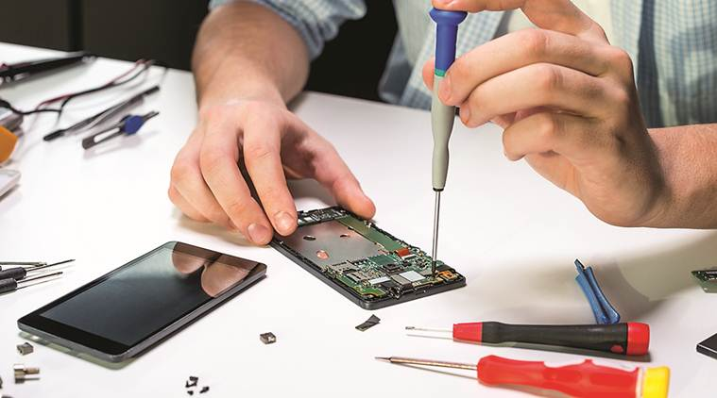
Top 3 Handset Manufacturers
Apple - 59565
Samsung - 40839
Huawei - 34423

Slide 4
Top 5 Handsets per Manufacturer
*Apple *Huawei
Apple iPhone 6S (A1688) 9419 Huawei B528S-23A 19752
Apple iPhone 6 (A1586) 9023 Huawei E5180 2079
Apple iPhone 7 (A1778) 6326 Huawei P20 Lite Huawei Nova 3E 2021
Apple iPhone Se (A1723) 5187 Huawei P20 1480
Apple iPhone 8 (A1905) 4993 Huawei Y6 2018 997
*Samsung
Samsung Galaxy S8 (Sm-G950F) 4520
Samsung Galaxy A5 Sm-A520F 3724
Samsung Galaxy J5 (Sm-J530) 3696
Samsung Galaxy J3 (Sm-J330) 3484
Samsung Galaxy S7 (Sm-G930X) 3199

Slide 5
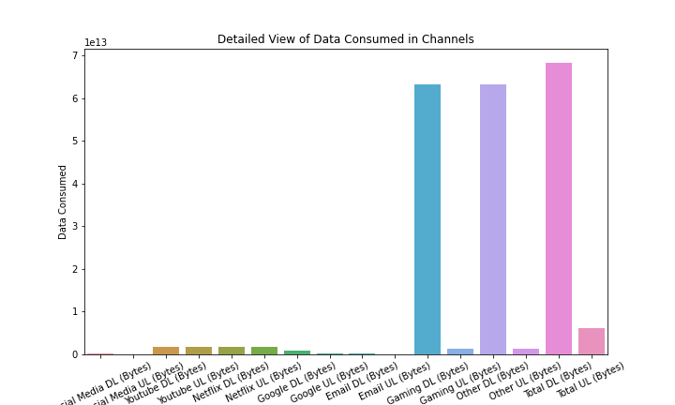
The Graph shows the Detailed View of Data Consumed in Different Channels:-
We can see that Maximum Data is consumed in Total DL(Bytes),Other DL(Bytes) and Gaming DL(Bytes)
In other Channels Data consumed is less.

Slide 6
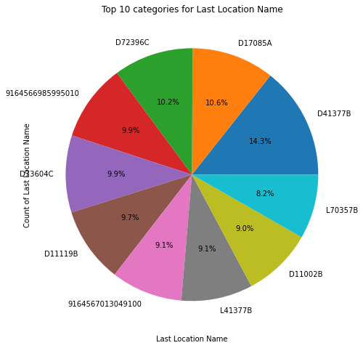
Top 10 categories for Last Location
D41377B 80
D17085A 59
D72396C 57
9164566985995010 55
D73604C 55
D11119B 54
9164567013049100 51
L41377B 51
D11002B 50
L70357B 46

Slide 7
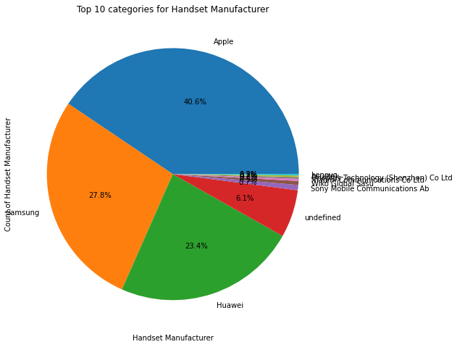
Top 10 categories for Handset Manufacturer
Apple 59565
Samsung 40839
Huawei 34423
undefined 8987
Sony Mobile Communications Ab 980
Wiko Global Sasu 747
Xiaomi Communications Co Ltd 397
Oneplus Technology (Shenzhen) Co Ltd 342
Asustek 285
Lenovo 254

Slide 8
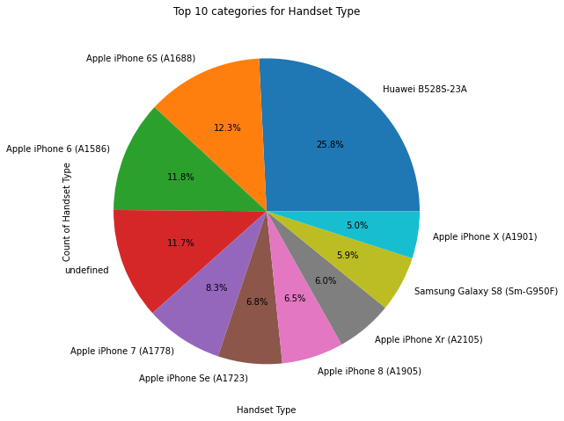
Top 10 categories for Handset Type
Huawei B528S-23A 19752
Apple iPhone 6S (A1688) 9419
Apple iPhone 6 (A1586) 9023
undefined 8987
Apple iPhone 7 (A1778) 6326
Apple iPhone Se (A1723) 5187
Apple iPhone 8 (A1905) 4993
Apple iPhone Xr (A2105) 4568
Samsung Galaxy S8 (Sm-G950F) 4520
Apple iPhone X (A1901) 3813

Slide 9
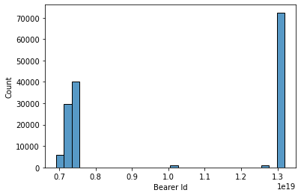
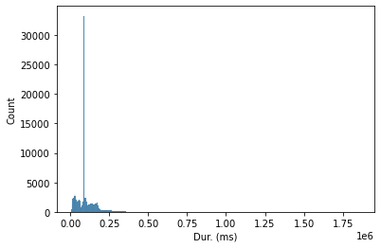
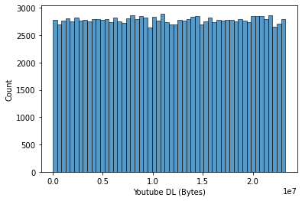
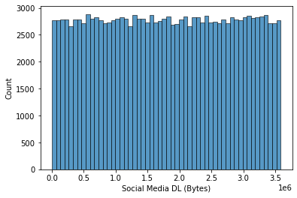
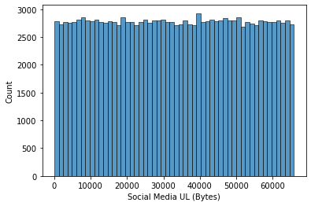
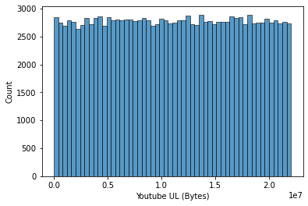
UNIVARIATE ANALYSIS

Slide 10
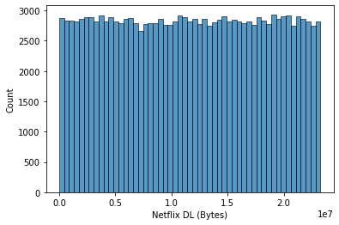
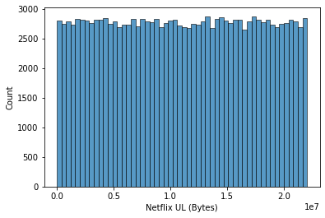
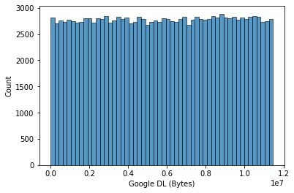
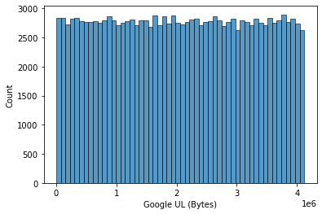
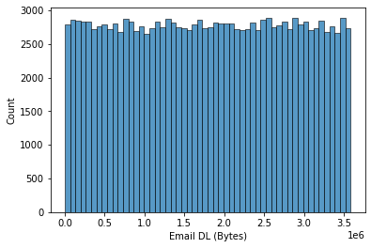
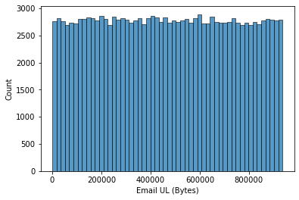
UNIVARIATE ANALYSIS

Slide 11
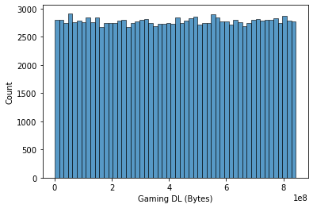
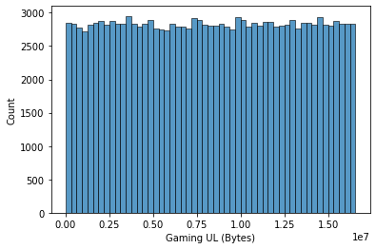
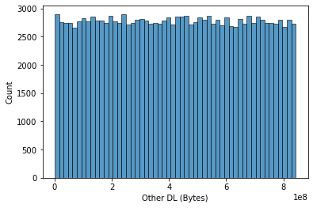
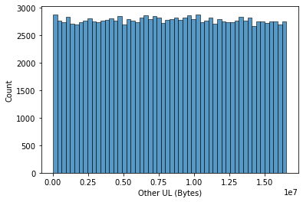
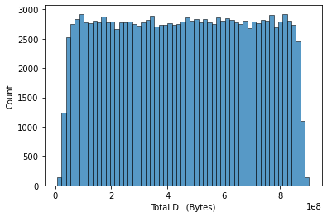
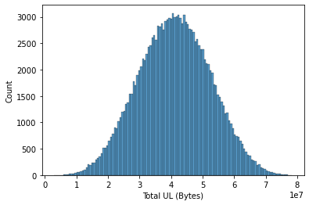
UNIVARIATE ANALYSIS

Slide 12
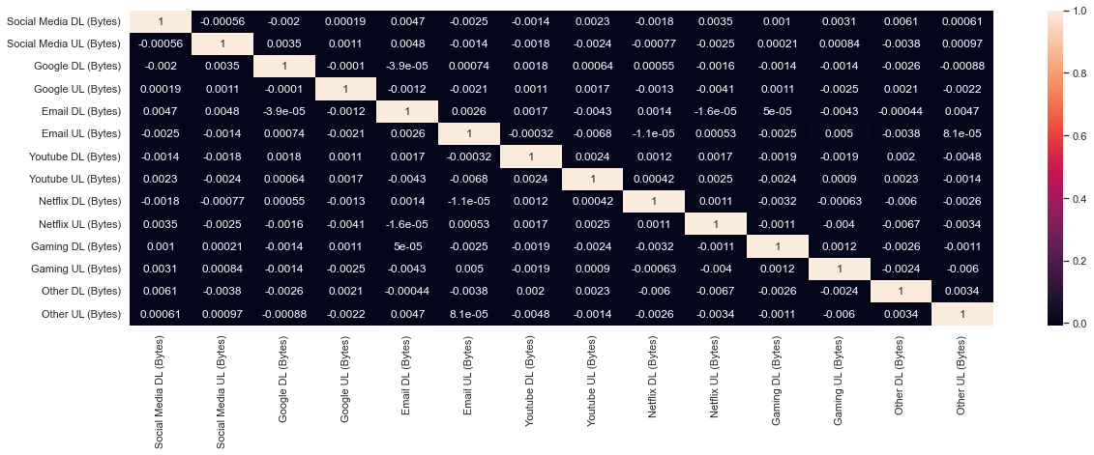
Correlation Matrix

Slide 13
Thank
You

